Slide 1
19AD784
IMAGE ANALYSIS AND COMPUTER VISION
Dr E Emerson Nithiyaraj
AP/ECE

Slide 2
UNIT II
IMAGE ENHANCEMENT
Dr E Emerson Nithiyaraj
AP/ECE

Slide 3
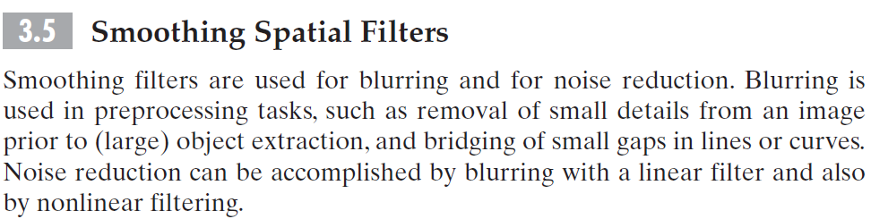

Slide 4
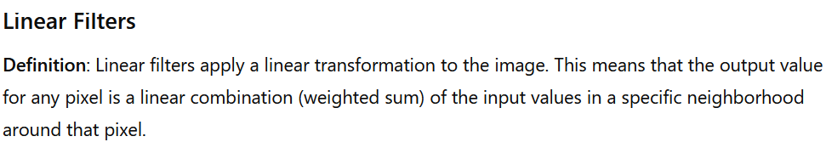
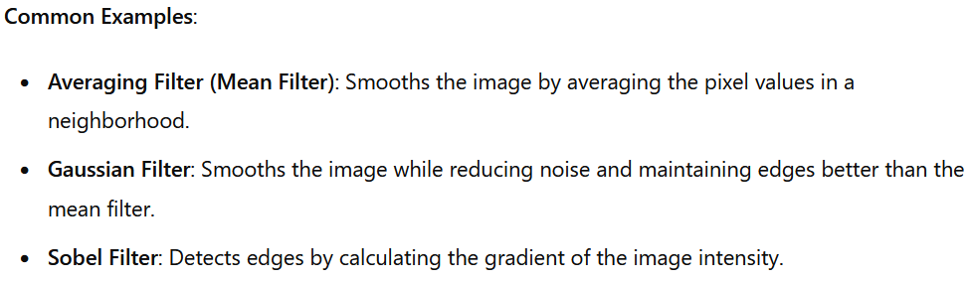

Slide 5
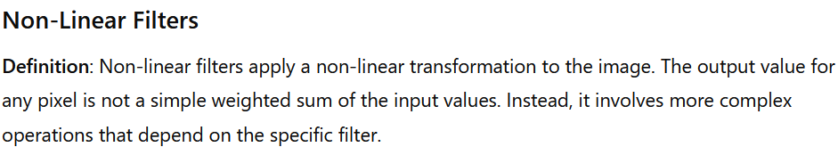
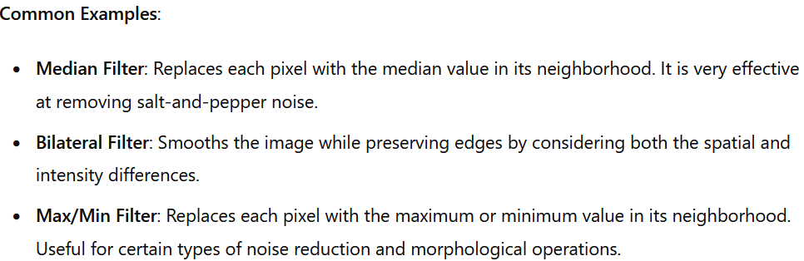

Slide 6
Smoothing Linear Filters
The output (response) of a smoothing, linear spatial filter is simply the average of the pixels contained in the neighborhood of the filter mask. These filters sometimes are called averaging filters or lowpass filters.
The value of every pixel in an image is replaced by the average of the intensity levels in the neighborhood defined by the filter mask, this process results in an image with reduced “sharp” transitions in intensities.
Because random noise typically consists of sharp transitions in intensity levels, the most obvious application of smoothing is noise reduction.

Slide 7
Smoothing Linear Filters
However, edges (which almost always are desirable features of an image) also are characterized by sharp intensity transitions, so averaging filters have the undesirable side effect that they blur edges.
Another application of this type of process includes the smoothing of false contours that result from using an insufficient number of intensity levels.

Slide 8
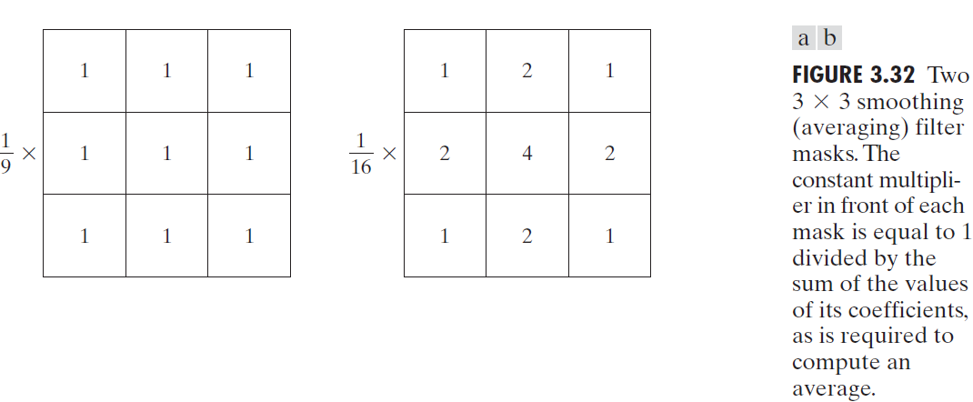

A spatial averaging filter in which all coefficients are equal sometimes is called a box filter.

Slide 9
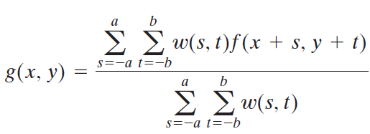
Pixels are multiplied by different coefficients, thus giving more importance (weight) to some pixels at the expense of others.
The pixel at the center of the mask is multiplied by a higher value than any other
The other pixels are inversely weighted as a function of their distance from the center of the mask.
The diagonal terms are further away from the center than the orthogonal neighbors.
By giving the center point the highest weight ensures that the central data remains clear and sharp, while still smoothing the overall data.

Slide 10
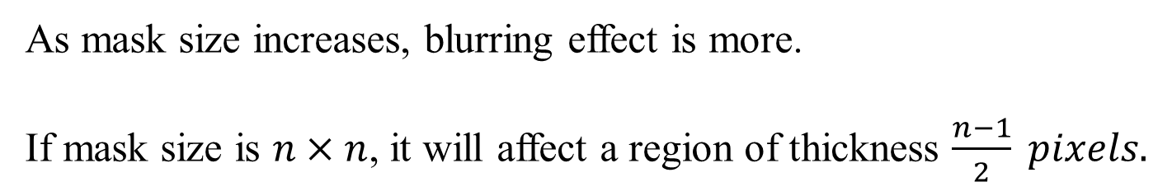
As mask size increases, blurring effect is more.
If mask size is $n×n$, it will affect a region of thickness $\frac{n−1}{2} pixels.$

Slide 11
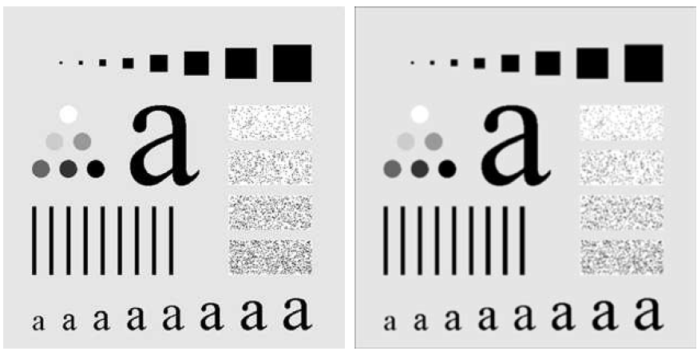

Slide 12
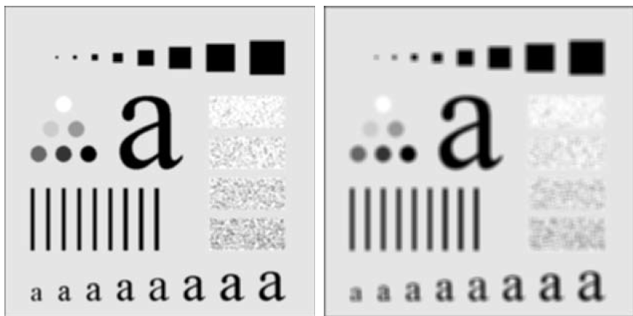

Slide 13
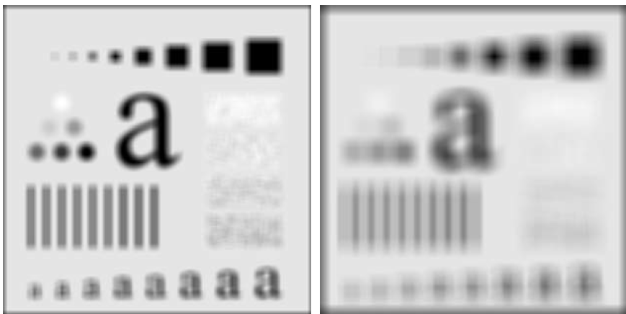

Slide 14
Smoothing Linear Filters
As mentioned earlier, an important application of spatial averaging is to blur an image for the purpose of getting a gross representation of objects of interest, such that the intensity of smaller objects blends with the background and larger objects become “bloblike” and easy to detect.
The size of the mask establishes the relative size of the objects that will be blended with the background.

Slide 15
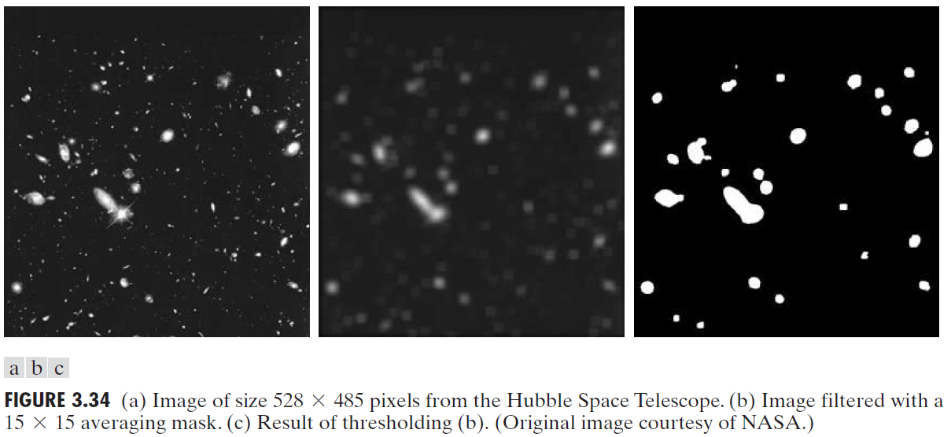

Slide 16
Order-Statistic (Nonlinear) Filters
Order-statistic filters are nonlinear spatial filters whose response is based on ordering (ranking) the pixels contained in the image area encompassed by the filter, and then replacing the value of the center pixel with the value determined by the ranking result.
The best-known filter in this category is the median filter, which, as its name implies, replaces the value of a pixel by the median of the intensity values in the neighborhood of that pixel.

Slide 17
Order-Statistic (Nonlinear) Filters
Median filters are quite popular because, for certain types of random noise, they provide excellent noise-reduction capabilities, with considerably less blurring than linear smoothing filters of similar size.
Median filters are particularly effective in the presence of impulse noise, also called salt-and-pepper noise because of its appearance as white and black dots superimposed on an image.

Slide 18
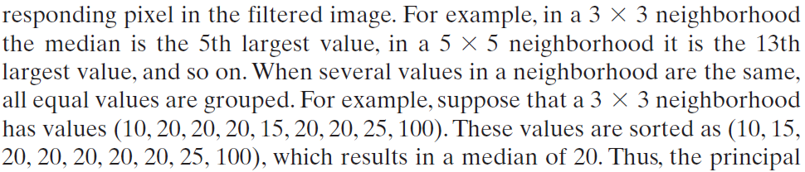
Order-Statistic (Nonlinear) Filters
Thus, the principal function of median filters is to force points with distinct intensity levels to be more like their neighbors.

Slide 19
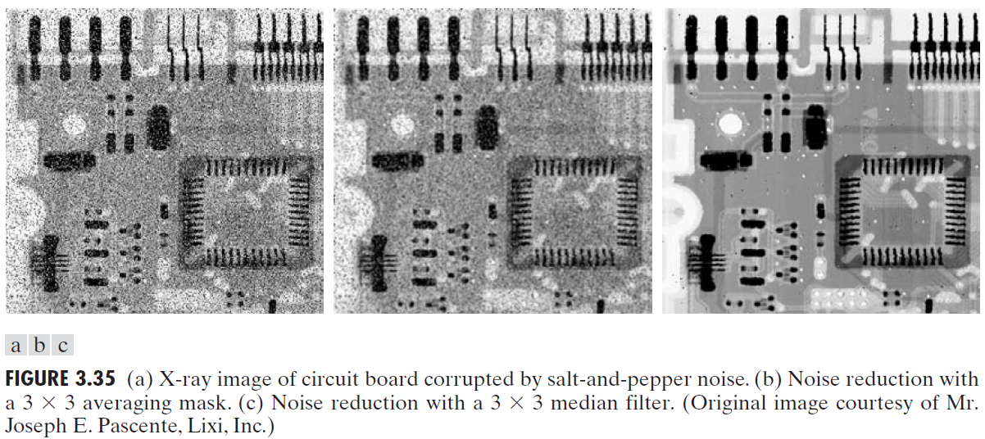

Slide 20
Sharpening Spatial Filters
The principal objective of sharpening is to highlight transitions in intensity.
In the last section, we saw that image blurring could be accomplished in the spatial domain by pixel averaging in a neighborhood.
Because averaging is analogous to integration, it is logical to conclude that sharpening can be accomplished by spatial differentiation.
Fundamentally, the strength of the response of a derivative operator is proportional to the degree of intensity discontinuity of the image at the point at which the operator is applied.

Slide 21
Sharpening Spatial Filters
Thus, image differentiation enhances edges and other discontinuities (such as noise) and deemphasizes areas with slowly varying intensities.

Slide 22
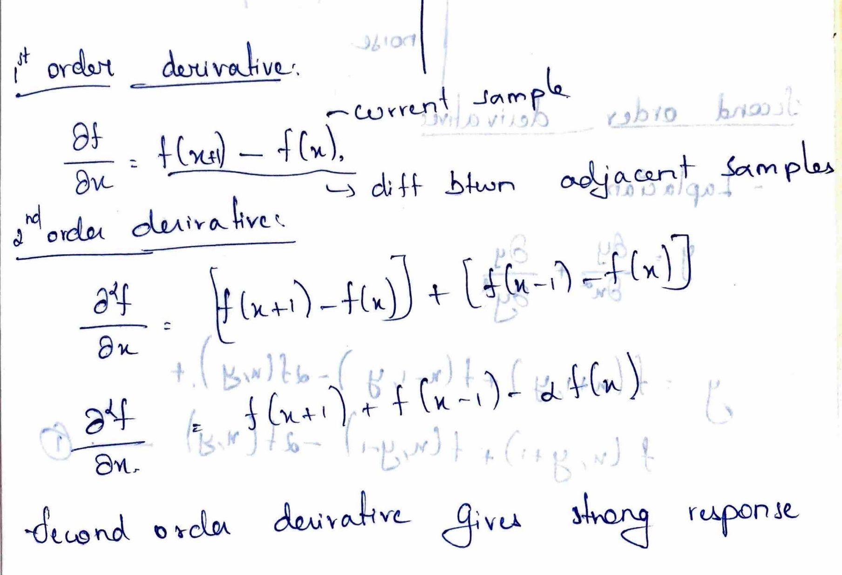

Slide 23
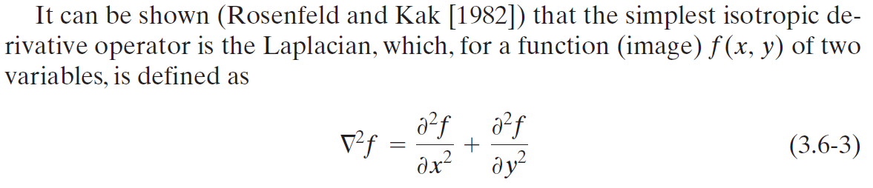
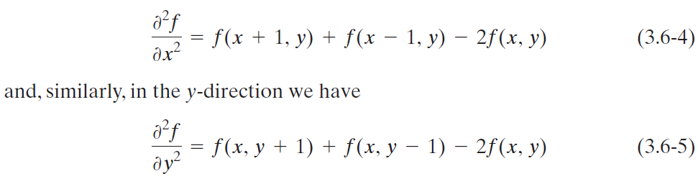
Using the Second Derivative for Image Sharpening—The Laplacian Spatial Filters

Slide 24
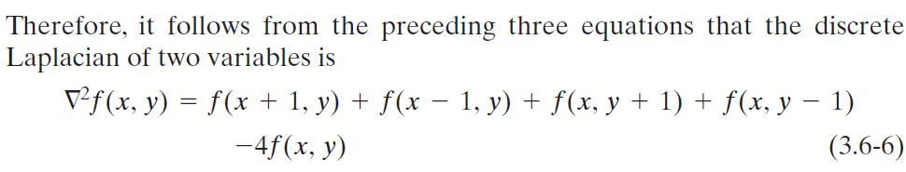
Using the Second Derivative for Image Sharpening—The Laplacian Spatial Filters
Isotropic filters are rotation invariant, in the sense that rotating the image and then applying the filter gives the same result as applying the filter to the image first and then rotating the result.

Slide 25
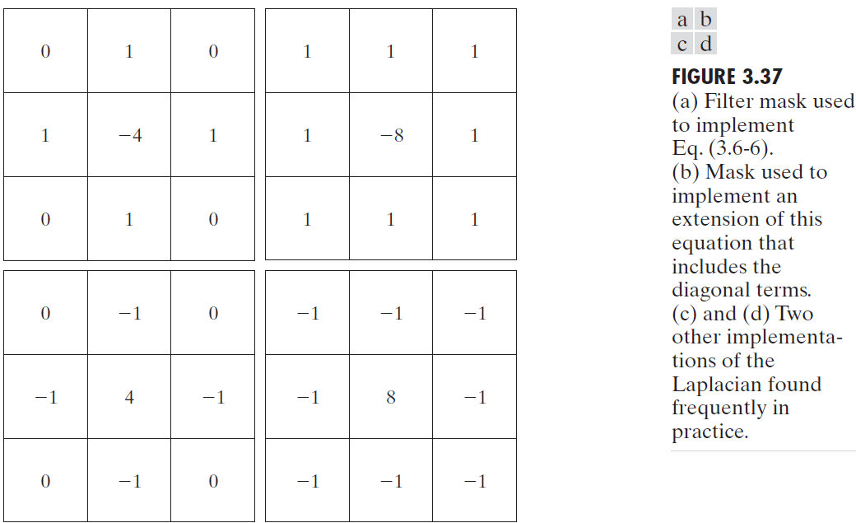
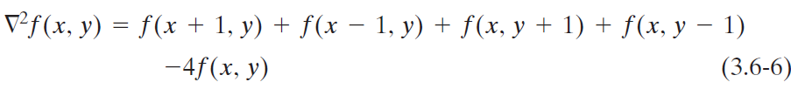

Slide 26
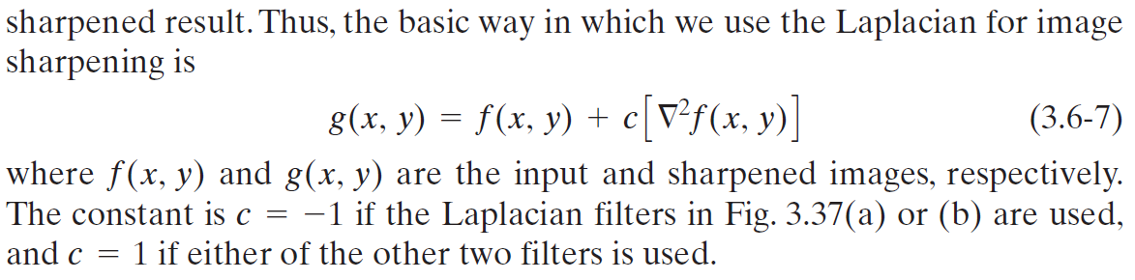

Slide 27
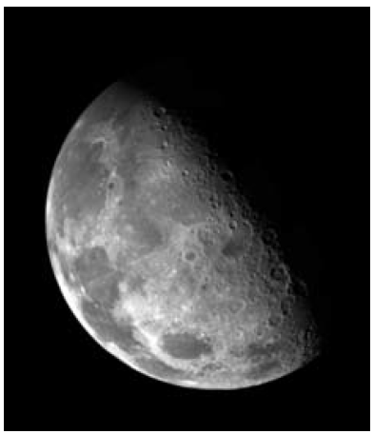
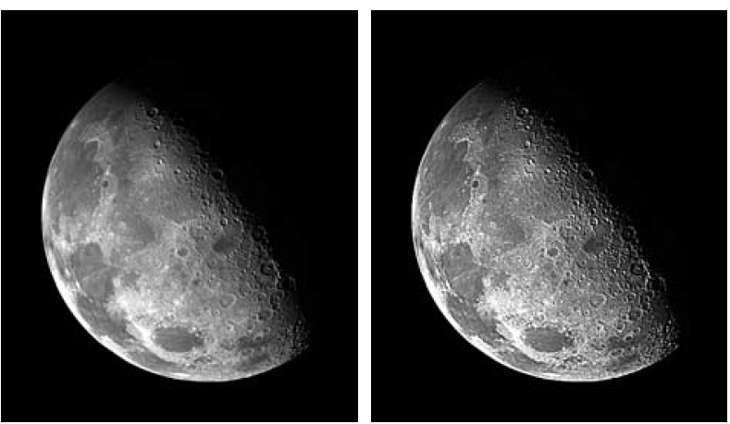
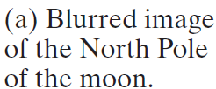
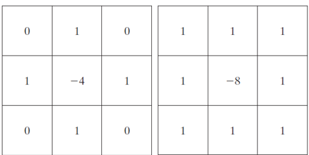

Slide 28
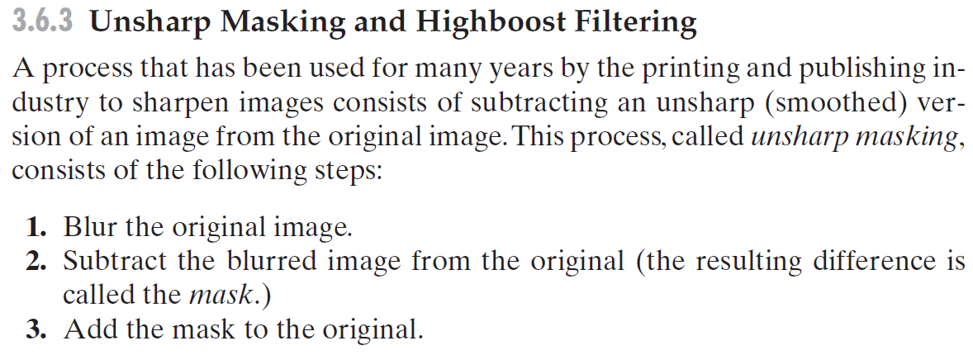

Slide 29
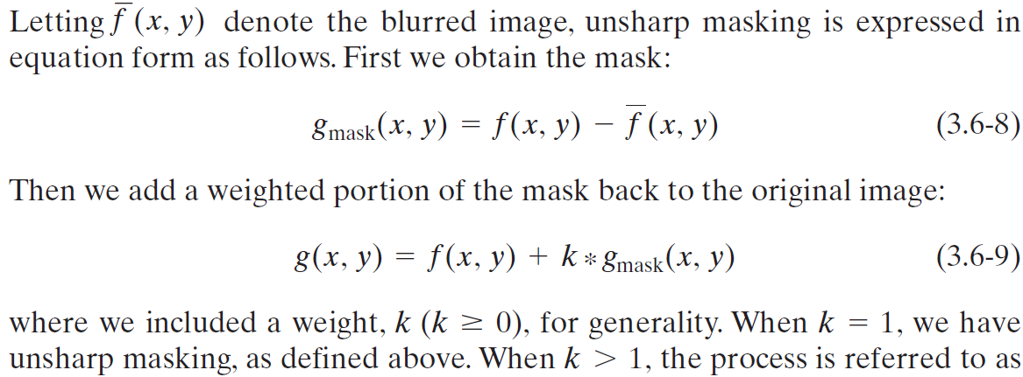

Slide 30
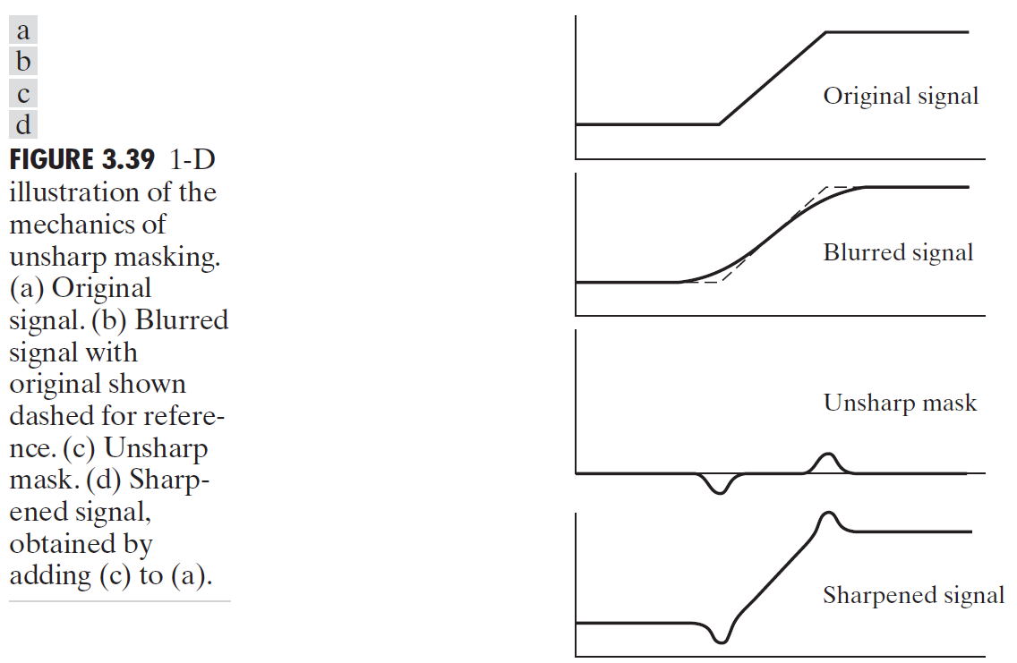

Slide 31
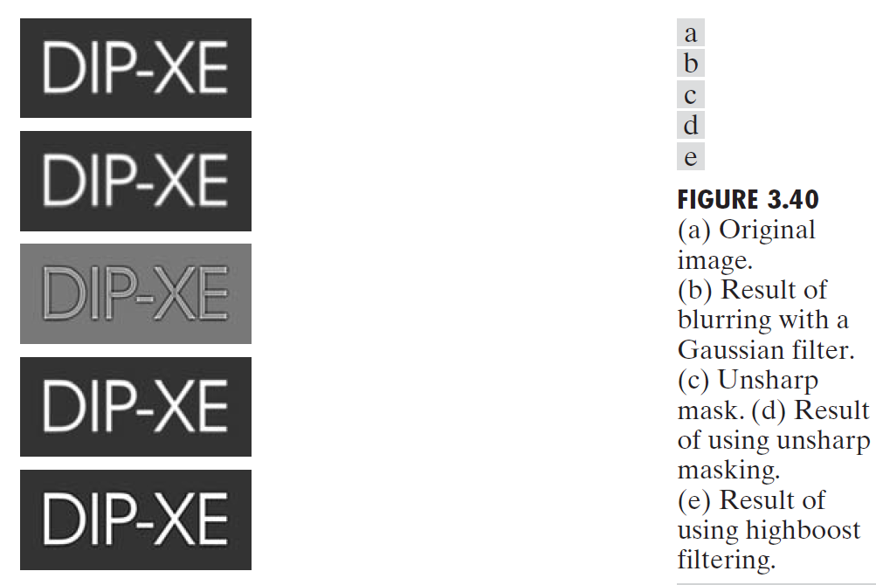




Slide 32
